Slide 1
EEPROM BASED DATA MEMORY

Slide 2
PIC uC have Electrically Erasable and Programmable Memory (EEPROM)
Limited number of bytes can be stored
Data written will be retained even when the power is switched off to the device
Constants, Sample value, Location etc retained for later use.

Slide 3
Four SFRs are involved
    EEDATA register(bank2)
    EEADR register (bank2)
    EECON1 register (bank3)
    EECON2 register (bank3)

Slide 4
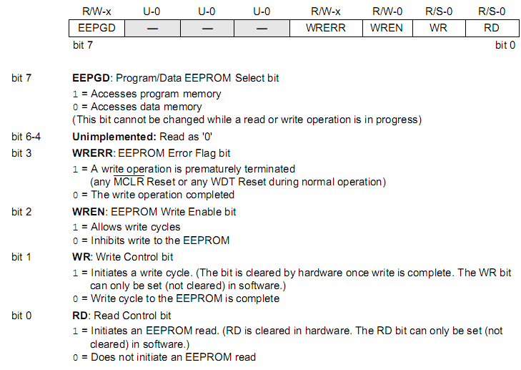

Slide 5
Read Operation
Load the desired source address into EEADR register.
Clear the EEPGD bit to point to EEPROM data memory.
Read the data in the selected location.
EECON1 being in Bank3, one has to switch to Bank3 to access EECON1<RD>
Transfer EEDATA to the desired location. EEDATA is in Bank2.

Slide 6
Write Operation
Disable all interrupts by clearing GIE. Bank 1 should be selected for GIE
Enable write operation by setting EECON1<WREN>
Carry out the following write sequence
0X55h →(EECON2)
0XAAh→ (EECON2) ; EECON2 does not exist physically and serves to protect EEPROM from accidental writing
The sequence is specified by the manufacturer
Carry out write operation by setting EE CON1 <WR>
Enable interrupts by setting GIE
Clear the WREN bit to disable program operations.

Slide 7
A dedicated timer within the processor controls the Write Operation;
further during the EEPROM memory write, processor clock is halted.
The clock becomes active and the processor resumes operation only when Write operation is completed.
This explains the need to keep all interrupts disabled during a write operation.

Slide 8
EEDATA READ
Algorithm
Switch to bank 2 for loading the address in EEADR.
Load address from which data has to be read in EEADR
Select bank3 to configure EECON1
→select data memory
→enable read operation
4. Go to bank2 to get the data from EEDATA register and store it to a memory location.
EEDATA READ

Slide 9
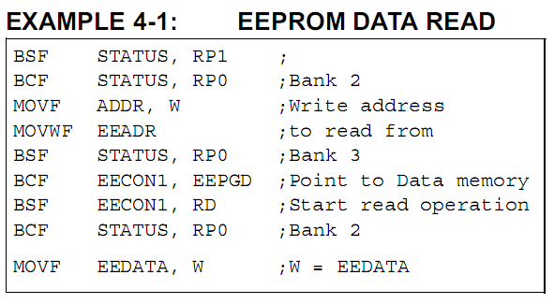

Slide 10
EEDATA WRITE
Algorithm
Check if the previous write operation is finished.
If yes, move the address to where the data is to be written in the EEADR register which is in bank2.
Then move the data that has to be written in EEDATA register which is also in bank2
Switch to bank3 for configuring EECON1.
→select data memory
→set WREN
Clear GIE for disabling any other interrupt while EECON2 is configuring.
Configure EECON2
→move the value 55h to EECON2
→move AAh to EECON2
Set WR bit
Enable interrupts
Clear WREN to disable program operations
At the completion of write cycle,the WR bit is cleared and EEIF interrupt flag bit is set.

Slide 11
